Slide 1
Task Management Application
By: Sihan Ma, Yuexuan Lu

Slide 2
Teammates & Role
Sihan Ma (@Masihan317)
Handled Vite setup and Built the main UI (responsive) with React Bootstrap.
Developed the Express Server, Implemented REST API endpoints and Integrated MongoDB.
Implemented add task, list all tasks, and delete tasks functionality.
Wrote Documentation (README.md and APIDOC.md).
Updated favicon.
Handled loading state of main page.
Deployed Application on Render.
Yuexuan Lu (@noiorhyun)
Implemented edit tasks, task filtering on home page
Added click button to switch task between completed and incomplete functionality.
Implemented View Detail Card.
Handled Overflow of Tasks.
Worked on most of the report (Architecture Diagram)

Slide 3
Task Manager Application Objective & Use Cases
Full Stack Web Application Project
Enables users to efficiently manage their tasks
User-friendly interface for CRUD operations & filtering
Responsive application accessible on both desktop & mobile devices
Use Cases
Task Creation
Task Retrieval
Task Updates
Task Deletion
Task Filtering
Toggling Task Completeness

Slide 4
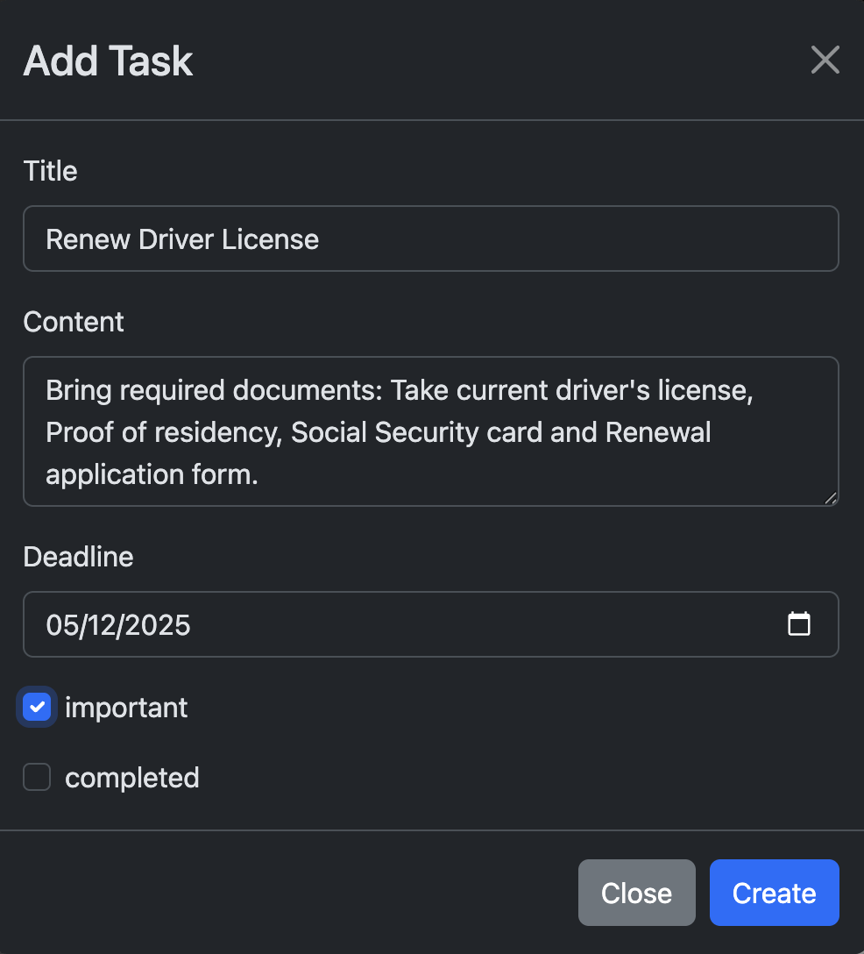
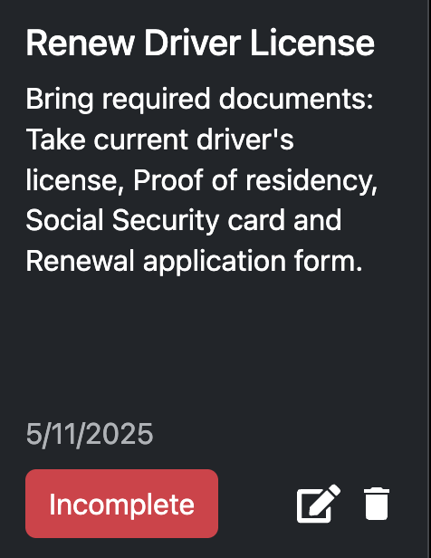
Task Creation: Adding a New Task

Slide 5
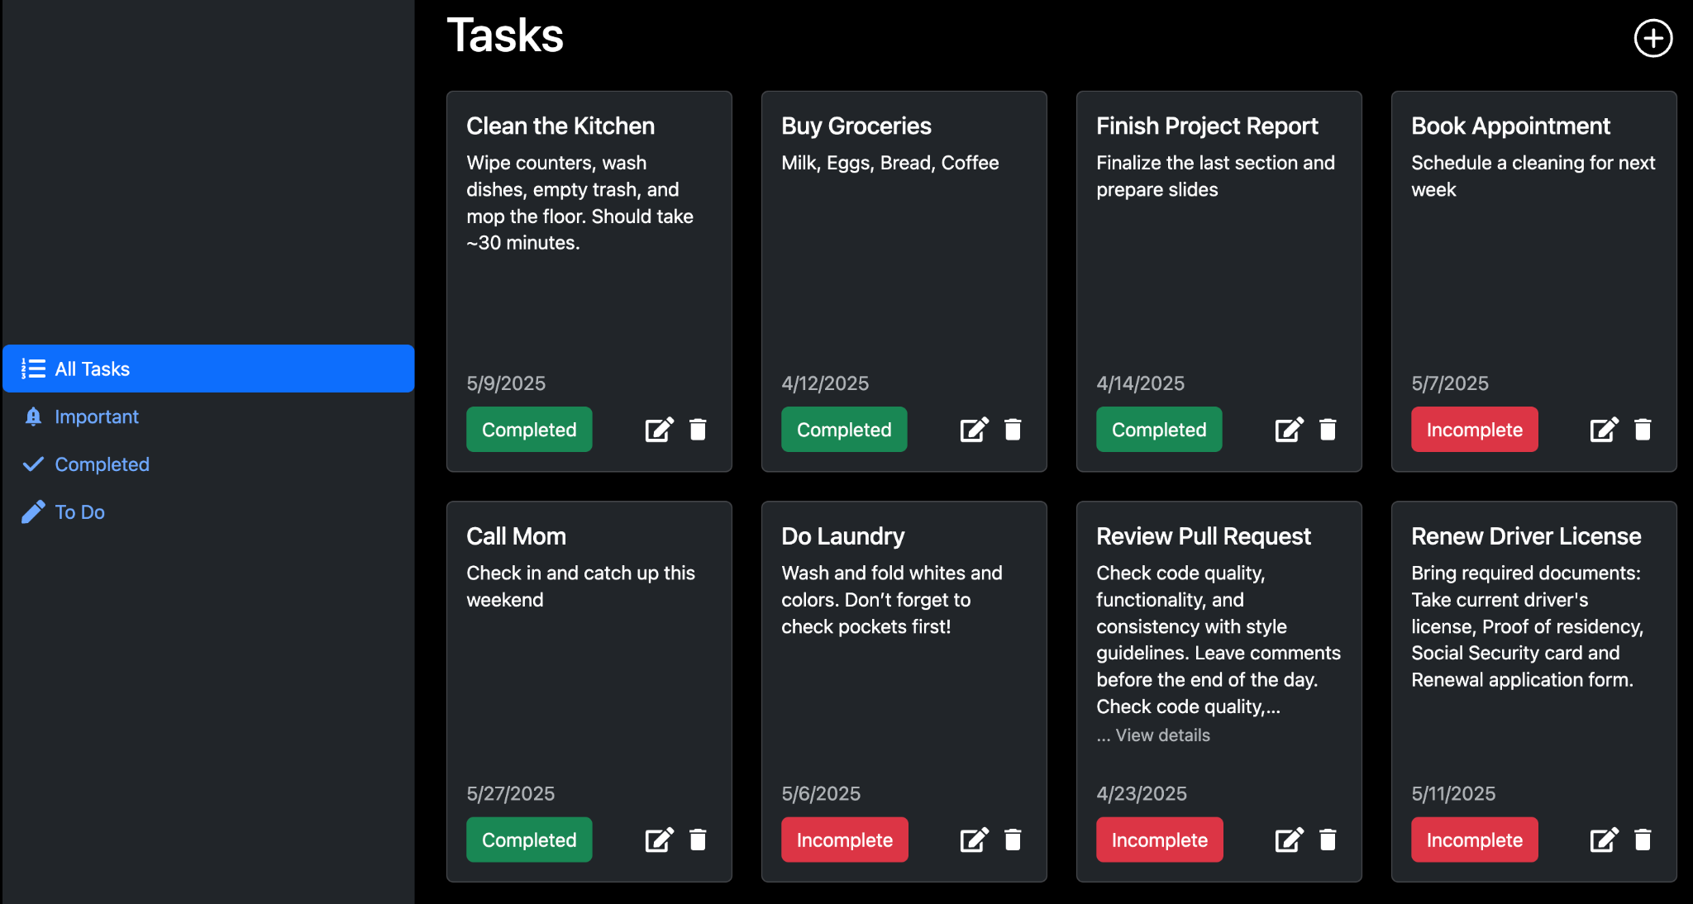
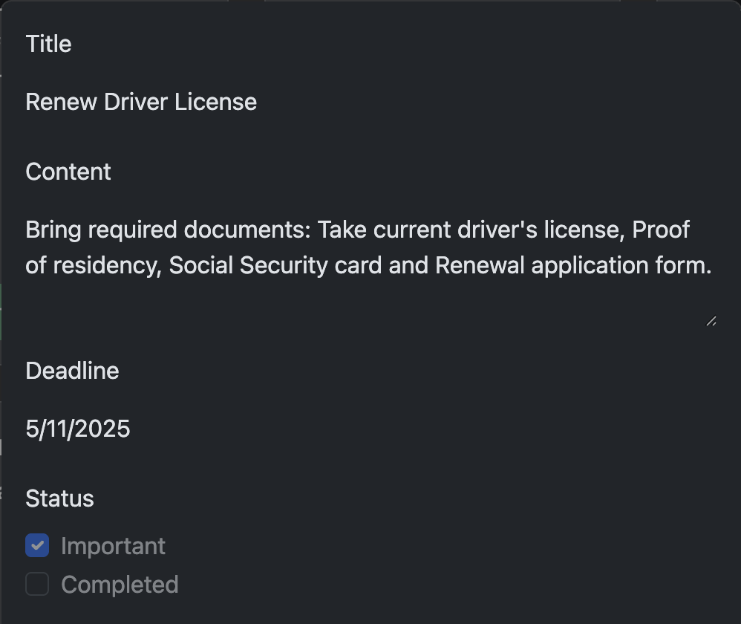
Task Listing and Viewing

Slide 6
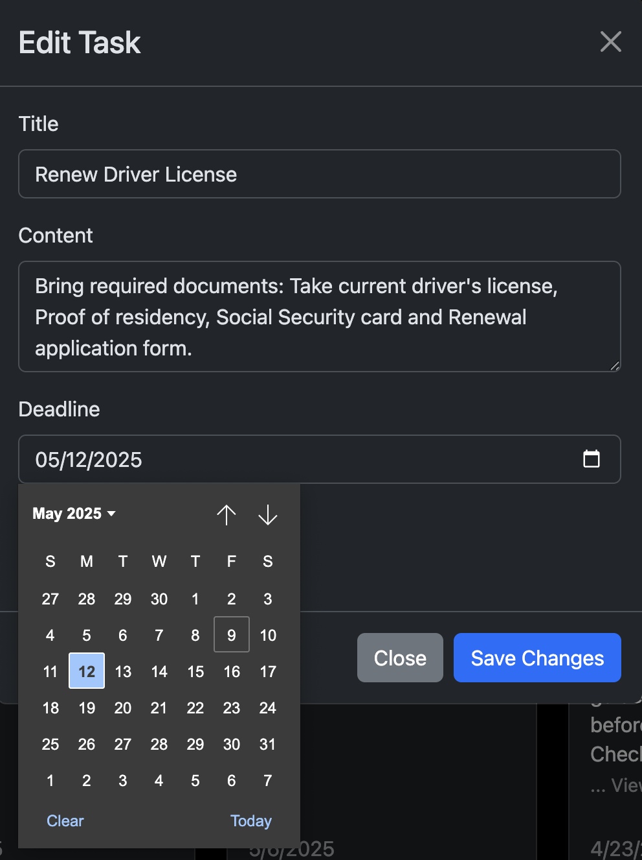
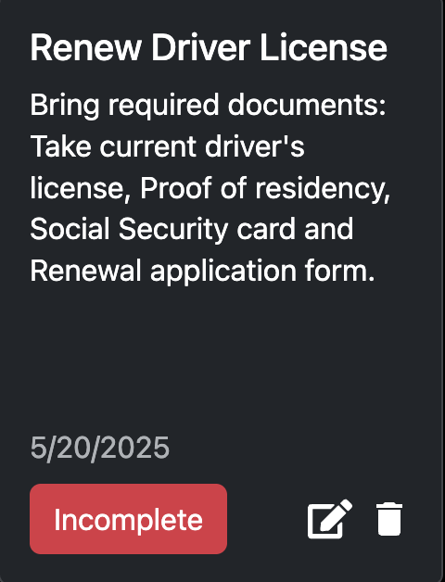
Task Updating

Slide 7
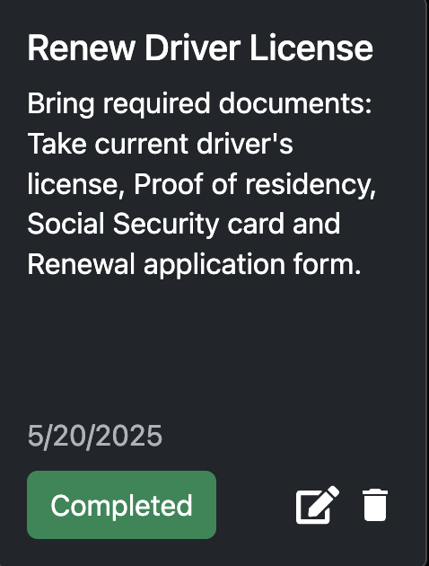
Toggling Task Completeness

Slide 8
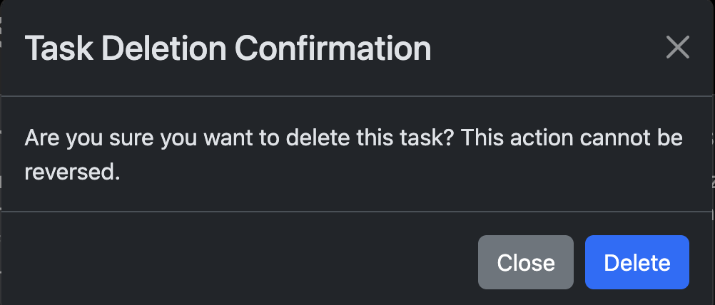
Task Deletion
Delete Button

Slide 9
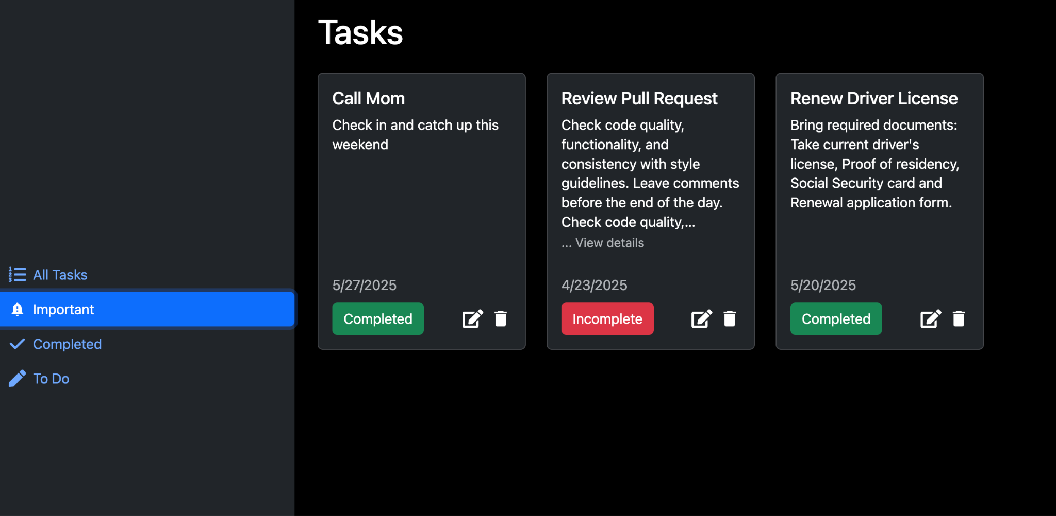
Task Filtering

Slide 10
Overview of Stack
Built with the MERN Stack
MongoDB: database to store all tasks.
Express.js: backend framework to handle requests.
React: frontend library to build the user interface.
Node.js: JavaScript runtime environment for the backend.
Plus:
React Bootstrap: Built-in Bootstrap styles, very great for responsiveness
Vite: JS Build Tool for a fast development experience.
Render: For easy online deployment.

Slide 11
Overview of Features
Add New Tasks
List All Tasks
Update A Task
Delete A Task
Confirmation Modal
View A Task
Overflow Handling
Filter Tasks By Category
Important/Completed
Toggle Task Completeness
Responsive View
Loading State
Spinner

Slide 12
Exciting Demo Time!
https://cs526-project.onrender.com/

Slide 13
Architecture Brief
Frontend
Frontend Makes HTTP requests via RESTful APIs
Displays the response returned from the backend accordingly
Backend
Defined endpoint routes to handle task operations
Backend processes the data from database operations and return accordingly
Database
Stores task data
Dataflow
User interacts with frontend - e.g. Adding a task
Frontend sends task to backend via API Call
Backend process data and save to database
Once Saved, backend sends res back to frontend, then frontend display in UI

Slide 14
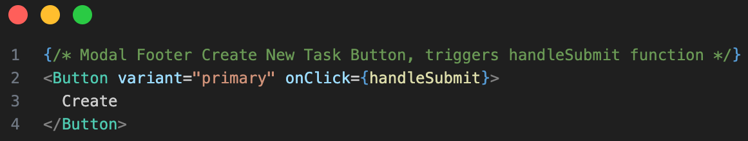
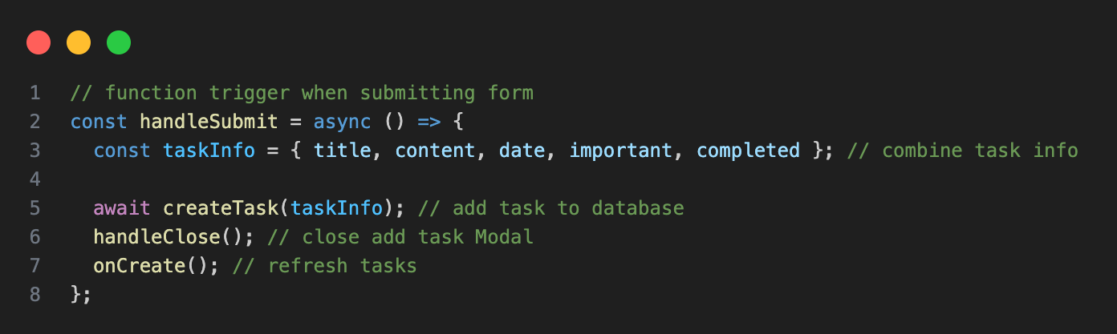
Example Data Flow

Slide 15
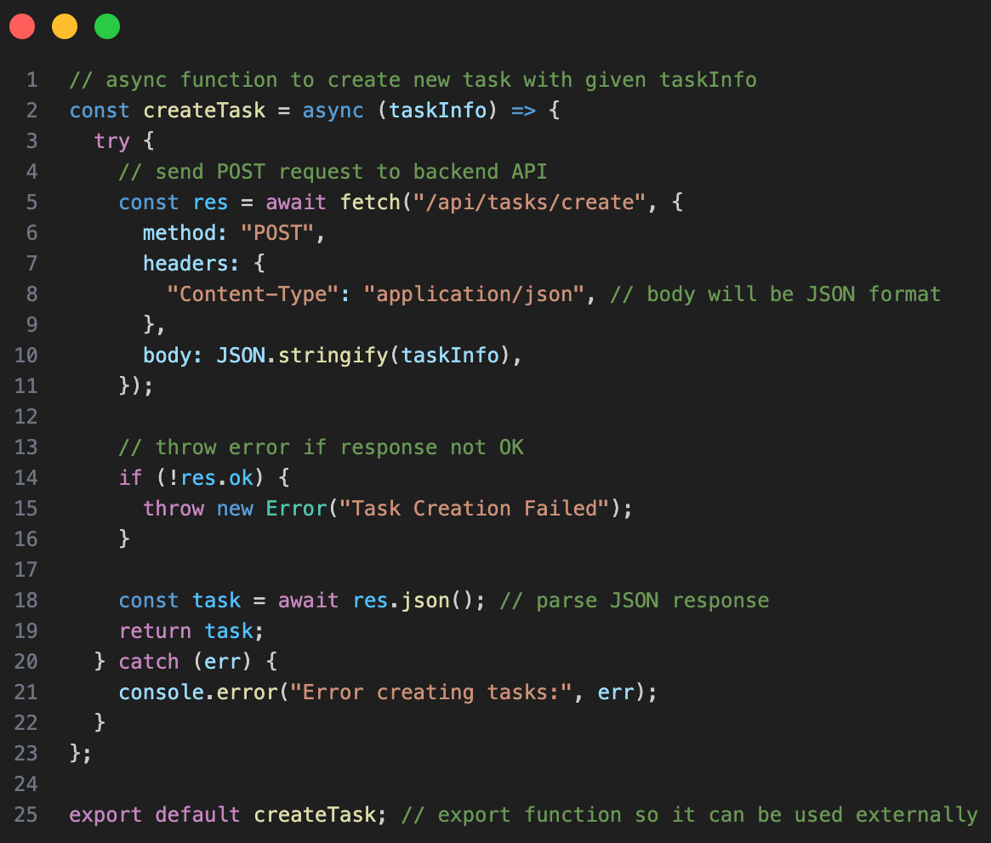

Slide 16
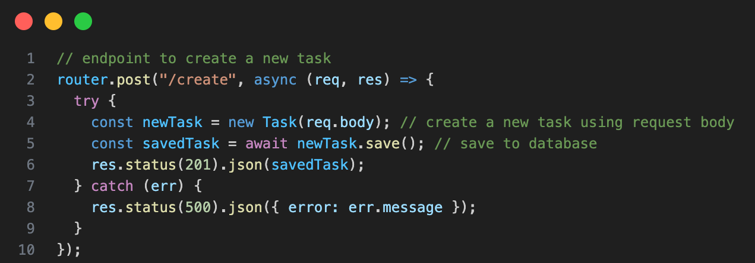
Example Data Flow

Slide 17
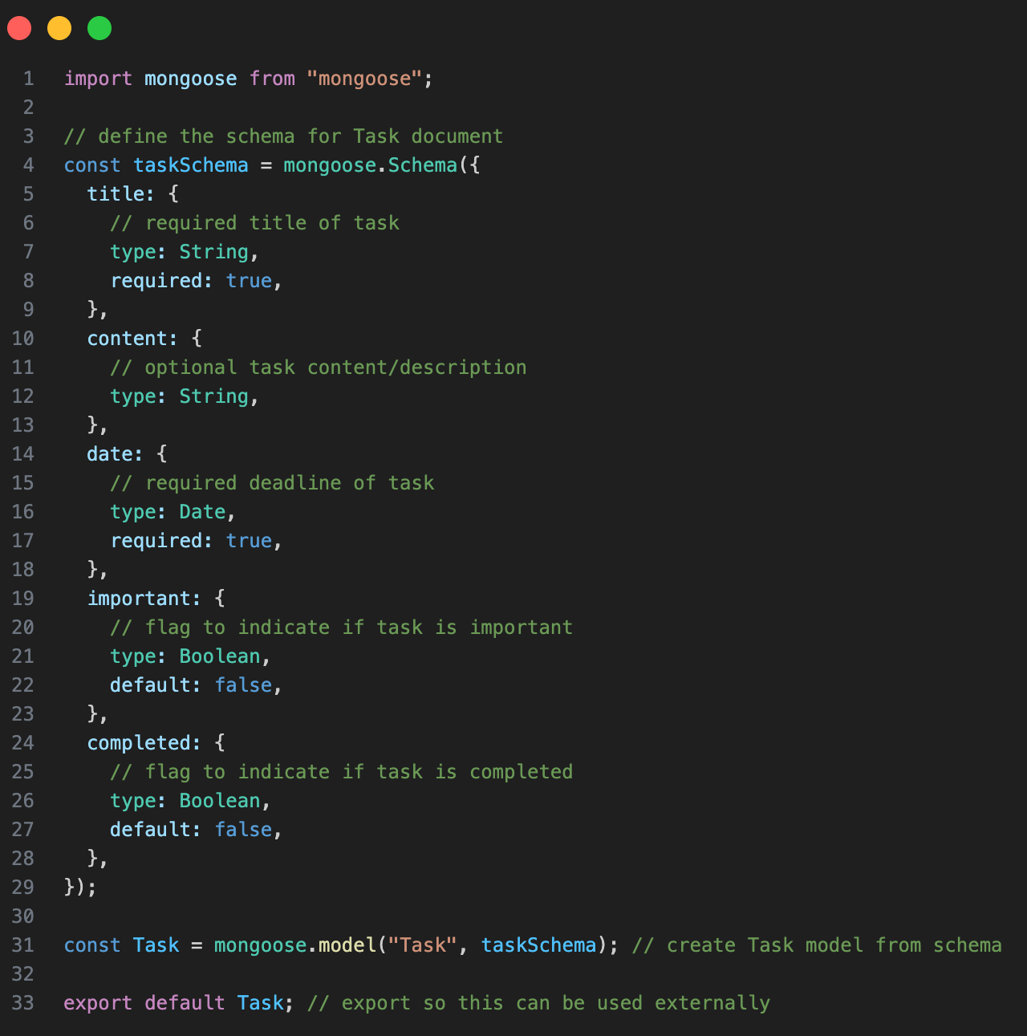

Slide 18
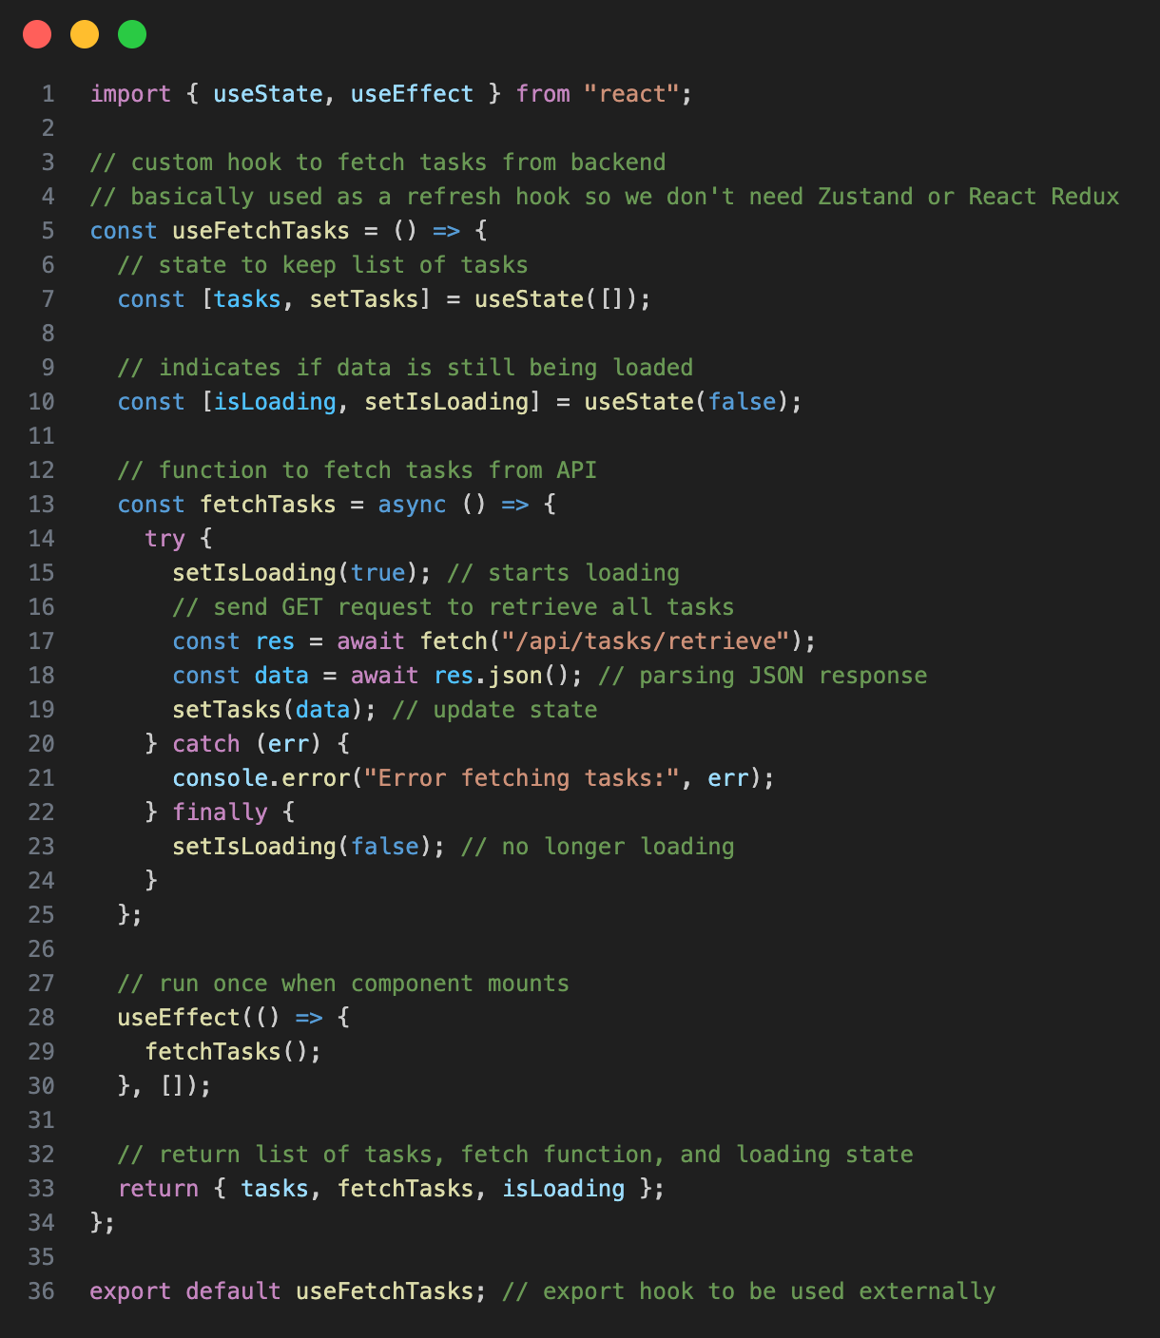
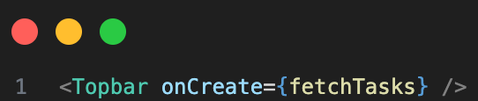
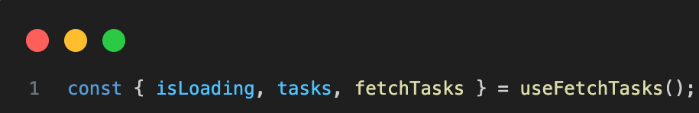

Slide 19
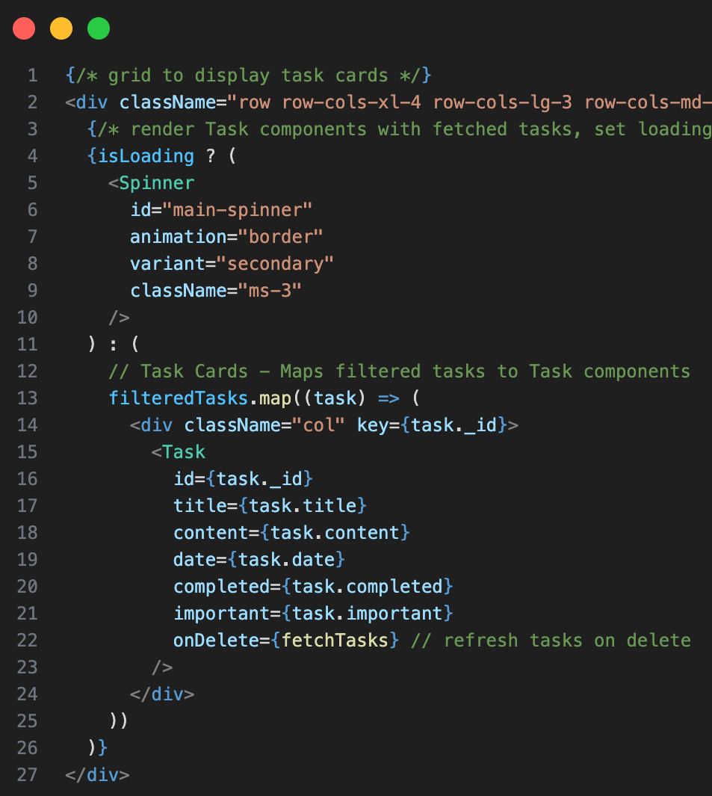
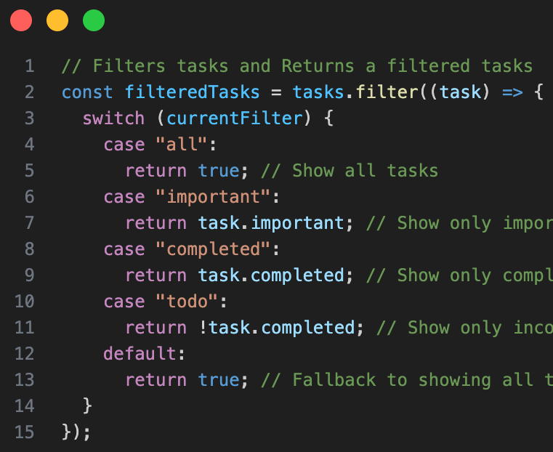

Slide 20
Challenges && Learnings
How To Read Documentation
Using React Bootstrap
How To Deploy
Frontend/Backend Integration
Build && Compatibility
How to keep track of changes in React
useState
How to implement task card Viewing
onClick handler
event.stopPropagation()

Slide 21
Improvements && Conclusion
Add Users Login
Password Hashing - Bcrypt
Cookies && Local Storage - JWT Token
Statement Management - Zustand || React Redux
UI Improvements
Skeleton Cards On Loading
Dark/Light Mode
Adding a Toast
Adding Tasks from the Calendar
create new tasks directly from the calendar interface

Slide 22
Thank you!!!

